Slide 1

LECTURE-16 Composition of Function, Inverse Operations

Slide 2
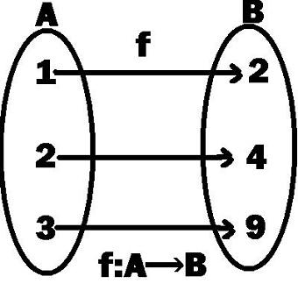
Functions are of different types:
One-to-one Function:
A function from A to B is one-to-one or injective, if for all elements x1,x2 in A such that f(x1) = f(x2), i.e x1=x2.
No elements of A are assigned to the same element in B and each element of the range corresponds to exactly one element in domain.

Slide 3
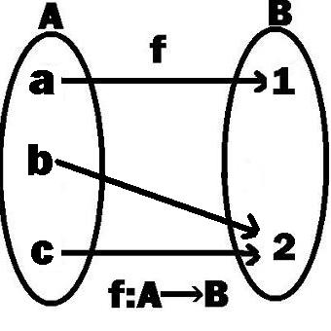
Onto Function:
A function from A to B is onto or surjective, if every element of B is the image of some element in A i.e all the elements of B has a pre-image in A.

Slide 4
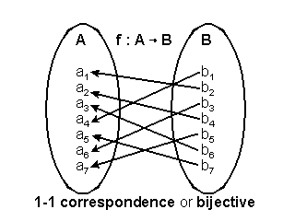
Bijective Function:
A function from A to B is one-to-one correspondence or bijective, if f is both injective(one-to-one) and surjective(onto).

Slide 5
Inverse of a Function :

Slide 6
Composition of Functions :

Slide 7
QUESTIONS :

Slide 8
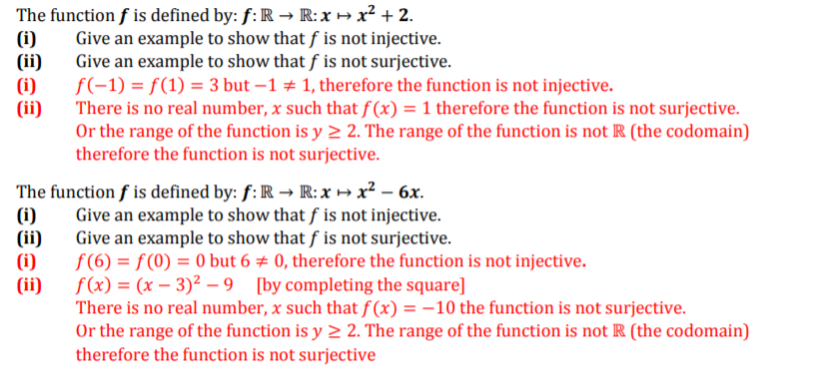
QUESTIONS :

Slide 9
QUESTIONS :

